Slide 1
Lecture 16
Pattern Sensitive and Electrical
Memory Test
Notation
Neighborhood pattern sensitive fault algorithms
Cache DRAM and ROM tests
Memory Electrical Parametric Tests
Summary

Slide 2
Notation
ANPSF -- Active Neighborhood Pattern Sensitive Fault
APNPSF – Active and Passive Neighborhood PSF
Neighborhood -- Immediate cluster of cells whose pattern makes base cell fail
NPSF -- Neighborhood Pattern Sensitive Fault
PNPSF -- Passive Neighborhood PSF
SNPSF -- Static Neighborhood Pattern Sensitive Fault

Slide 3
Neighborhood Pattern Sensitive Coupling Faults
Cell i’s ability to change influenced by all other memory cell contents, which may be a 0/1 pattern or a transition pattern.
Most general k-Coupling Fault
Base cell -- cell under test
Deleted neighborhood -- neighborhood without the base cell
Neighborhood is single position around base cell
Testing assumes read operations are fault free

Slide 4
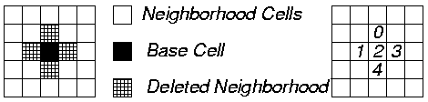
Type 1 Active NPSF
Active: Base cell changes when one deleted neighborhood cell transitions
Condition for detection & location: Each base cell must be read in state 0 and state 1, for all possible deleted neighborhood pattern changes.
C _{i,j} <d₀, d₁, d₃, d₄ ; b>
C _{i,j} <0, , 1, 1; 0> and C _{i,j} <0, , 1, 1; >

Slide 5
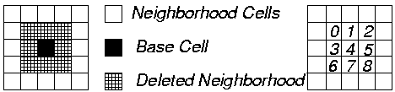
Type 2 Active NPSF
Used when diagonal couplings are significant, and do not necessarily cause horizontal/vertical coupling

Slide 6
Passive NPSF
Passive: A certain neighborhood pattern prevents the base cell from changing
Condition for detection and location: Each base cell must be written and read in state 0 and in state 1, for all deleted neighborhood pattern changes.
/ 0 ( /1) -- Base cell fault effect indicating that base cannot change

Slide 7
Static NPSF
Static: Base cell forced into a particular state when deleted neighborhood contains particular pattern.
Differs from active -- need not have a transition to sensitive SNPSF
Condition for detection and location: Apply all 0 and 1 combinations to k-cell neighborhood, and verify that each base cell was written.
C_{i,j} < 0, 1, 0, 1; - / 0> and C_{i,j} < 0, 1, 0, 1; - / 1>

Slide 8
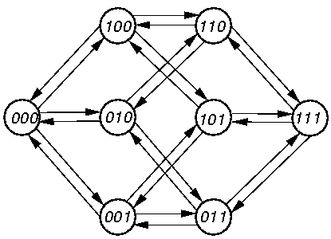
Eulerian / Hamiltonian Graph Tour Sequences
Both used for writing shorter patterns
Hamiltonian – traverses each graph node once
Eulerian – traverses each graph arc exactly once

Slide 9
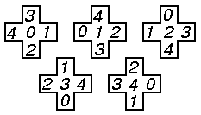
Type 1 Tiling Neighborhoods
Write changes k different neighborhoods
Tiling Method: Cover all memory with non-overlapping neighborhoods

Slide 10
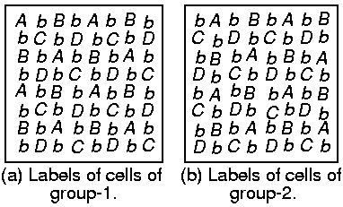
Two Group Method
Only for Type-1 neighborhoods
Use checkerboard pattern, cell is simultaneously a base cell in group 1, and a deleted neighborhood cell in 2

Slide 11
NPSF Fault Detection and Location Algorithm
write base-cells with 0;
loop
    apply a pattern; { it could change the base-cell from 0 to 1. }
    read base-cell;
  endloop;
write base-cells with 1;
loop
    apply a pattern; { it could change the base-cell from 1 to 0. }
    read base-cell;
  endloop;

Slide 12
NPSF Testing Algorithm Summary
A: active, P: passive, S: static
D: Detects Faults, L: Locates Faults
Algorithm
TDANPSF1G
TLAPNPSF1G
TLAPNPSF2T
TLAPNPSF1T
TLSNPSF1G
TLSNPSF1T
TLSNPSF2T
TDSNPSF1G
Fault
Loca-
tion?
No
Yes
Yes
Yes
Yes
Yes
Yes
No
Fault Coverage
Oper-
ation
Count
163.5 n
195.5 n
5122 n
194 n
43.5 n
39.2 n
569.78 n
36.125 n
SAF
L
L
L
L
L
L
L
L
TF
L
L
L
NPSF
A
D
L
L
L
P
L
L
L
S
L
L
L
L
D

Slide 13
NPSF Testing Algorithms
Algorithm
TDANPSF1G
TLAPNPSF1G
TLAPNPSF2T
TLAPNPSF1T
TLSNPSF1G
TLSNPSF1T
TLSNPSF2T
TDSNPSF1G
Neigh-
bor-
hood
Type-1
Type-1
Type-2
Type-1
Type-1
Type-1
Type-2
Type-1
Method
2 Group
2 Group
Tiling
Tiling
2 Group
Tiling
Tiling
2 Group
k
5
5
9
5
5
5
9
5

Slide 14
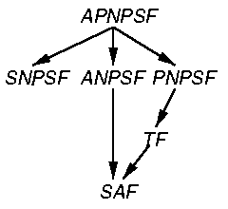
Fault Hierarchy

Slide 15
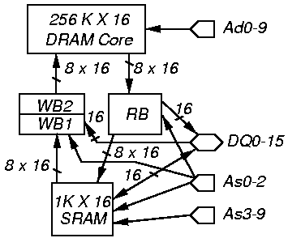
Cache DRAM Testing
Combines DRAM with SRAM cache

Slide 16
Required Cache DRAM Tests
DRAM Functional Test
SRAM Functional Test
Data Transfer Test between SRAM and DRAM
High-Speed Operation Test (100 MHz)
Concurrent Operation Test
Cache Miss Test

Slide 17
Testing Extremely Fast DRAMS -- RAMBUS
Use cheap and paid for ATE for die-sort test, burn-in test, & failure analysis
Use expensive, high-speed Hewlett-Packard 500 MHz HP-8300, F660 ATE with design-for-testability (DFT) hardware for high-speed interface logic test
  Allows direct memory core access at pins
  Bypasses high-speed bus
  Use cheap, slow ATE for memory test with PLL
  Need low-inductance socket, short cables, PLL jitter testing, & time-domain reflectometry
  Need critical path-delay fault timing tests

Slide 18
Functional ROM Testing
Unidirectional SAF model -- only sa0 faults or only sa1 faults
Store cyclic redundancy code (CRC) on ROM, ATE reads ROM & recomputes CRC, compares with ROM CRC
  Tests single-bit errors, double-bit errors, odd-bit errors, multiple adjacent errors

Slide 19
Electrical Testing
Test for:
  Major voltage / current / delay deviation from part data book value
  Unacceptable operation limits
  Divided bit-line voltage imbalance in RAM
  RAM sleeping sickness -- broken capacitor, leaks -- shortens refresh interval

Slide 20
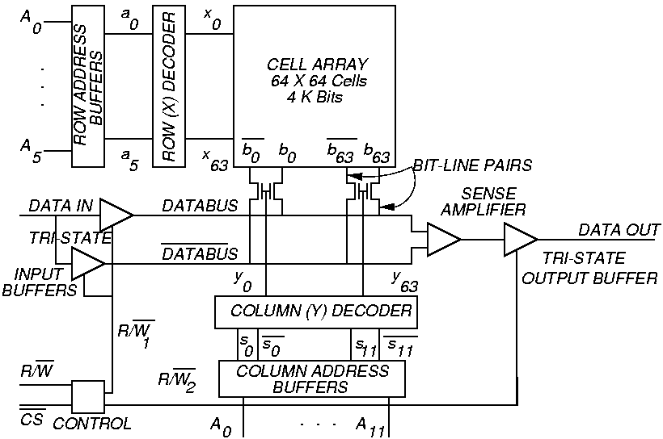
RAM Organization

Slide 21
DC Parametric Tests
Production test -- done during burn-in
  Applied to all chips
  Chips experience high temperature + over-voltage power supply
  Catches initial, early lifetime component failures -- avoid selling chips that fail soon

Slide 22
Test Output Leakage Current
1.
2.
3.
4.
5.
6.
7.
1.
2.
3.
Apply high to chip select, deselect chip
Set chip pins to be in tri-state mode
Force high on each data-out line – measure I_{OZ}
Force low on each data-out line – measure I_{OZ}
Select chip (low on chip select)
Set read, force high on each address/data line,
measure I_{I}
Set read, force low on each address/data line,
measure I_{I}
Possible Test Outcomes:
I_{OZ} < 10 μA and I_{I} < 10 μA (passes)
I_{OZ} 10 μA (fails)
I_{I} 10 μA (fails)

Slide 23
Voltage Bump Test
Tests if power supply variations make RAM read out bad data -- DRAM C shorted to supply
1.
2.
3.
4.
1.
Zero out memory.
Increase power above V_{CC} in 0.01 V. steps.
For each voltage, read memory. Stop as soon as
1 is read anywhere, record supply V. as V_{high}
Fill memory with 1’s.
Decrease power below V_{CC} in 0.01 V. steps.
For each voltage, read memory. Stop as soon as
0 is read anywhere, record supply V. as V_{low}.
Possible Test Outcomes:
V_{high} and V_{low} inconsistent with data book (fails)

Slide 24
AC Parametric Tests
Set a DC bias voltage level on pins
Apply AC voltages at some frequencies & measure terminal impedance or dynamic resistance
Determines chip delays caused by input & output C’s
No information on functional data capabilities or DC parameters

Slide 25
Write Release Time Tests
t_{WC} – Write Cycle Time – minimum time required for 1 write cycle
t_{WR} -- Address set-up time sensitivity – Write Release Time that address must be held stable after CS is released during write
t_{WC}
Address
t_{WR}
CS
WE

Slide 26
Access Time Tests
1.
2.
3.
4.
1.
Split memory into 2 halves.
Write 0 in 1st half and 1 in other half.
Read entire memory and check correctness.
Alternate between addresses in two halves
Speed up read access time until reading fails,
and take that time as access time delay.
Characterization:
  Use MATS++ with increasingly shorter access time until failure.
  Use March C instead of MATS++.
Production test: run MATS++ at specified access time, and see if memory fails.

Slide 27
Running Time Tests
Method:
Perform read operations of 0s and 1s from
alternating addresses at specified rapid speed.
Alternate characterization method:
Alternate read operations at increasingly rapid
speeds until an operation fails.

Slide 28
Sense Amplifier Recovery Fault Tests
Write operation followed by read/write at different address
Method:
Write repeating pattern dddddddd to memory
locations (d is 0 or 1);
Read long string of 0s (1s) starting at 1st
location up to location with d.
Read single 1 (0) from location with d.
Repeat Steps 2 and 3, but writing rather than
reading in Step 2.
1.
2.
3.
4.

Slide 29
Dual-Port
SRAM Tests

Slide 30
Standby Current Test
Method:
Check all 4 possibilities for voltage
combinations at 2 ports. 4 more
Combinations occur if both ports have
either TTL or CMOS level inputs.
Possible Test Outcomes:
Test fails if one port does not meet the
current specification.

Slide 31
Tests of Dual-Ported RAMs
Test both RAM access ports simultaneously
  Write data into interrupt location of 1 port
  Monitor INT output of other port to see if interruption sensed at other port

Slide 32
Arbitration Test
Test arbitration hardware between 2 ports in RAM
If semaphore does not set or release, or if RAM locks up, then chip is faulty
Semaphore Testing Method:
For each port, request, verify, and release
each semaphore latch.

Slide 33
Memory Testing Summary
Multiple fault models are essential
Combination of tests is essential:
  March -- SRAM and DRAM
  NPSF -- DRAM
  DC Parametric -- Both
  AC Parametric -- Both
Inductive Fault Analysis is now required

